Slide 2
compute angle between hands of clock in different situations.
solve problem related to angle computation between hands of clock in various competitive exams.

Slide 3
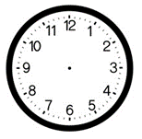
Example 1
Find the angle between the minute hand and the hour hand of a clock when the time is 9.20 am.

Slide 4
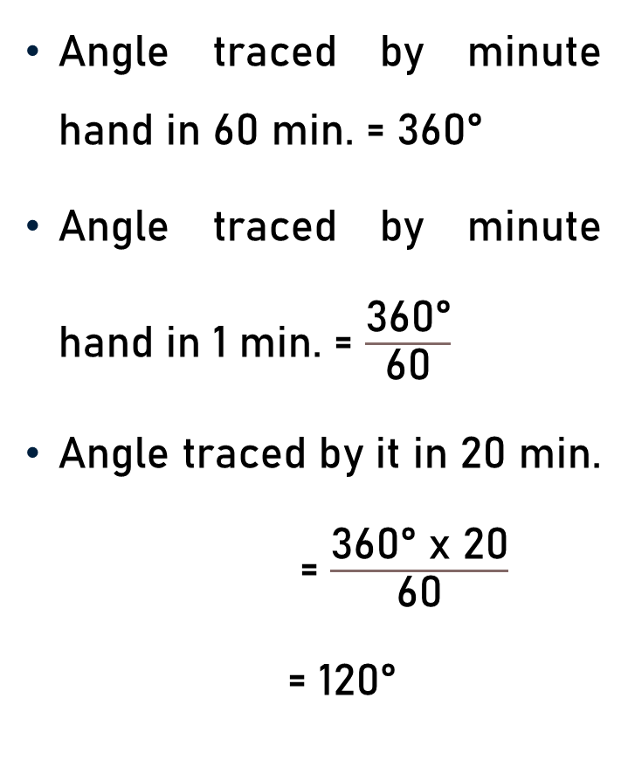

Example 1
Angle traced by minute hand in 60 min. = 360°
Angle traced by minute hand in 1 min. = $\frac{\text{360}\text{°}}{\text{60}}$
Angle traced by it in 20 min. = $\frac{\text{360°} \text{x}\text{ 20}}{\text{60}}$
= 120°
120$\text{°}$

Slide 5
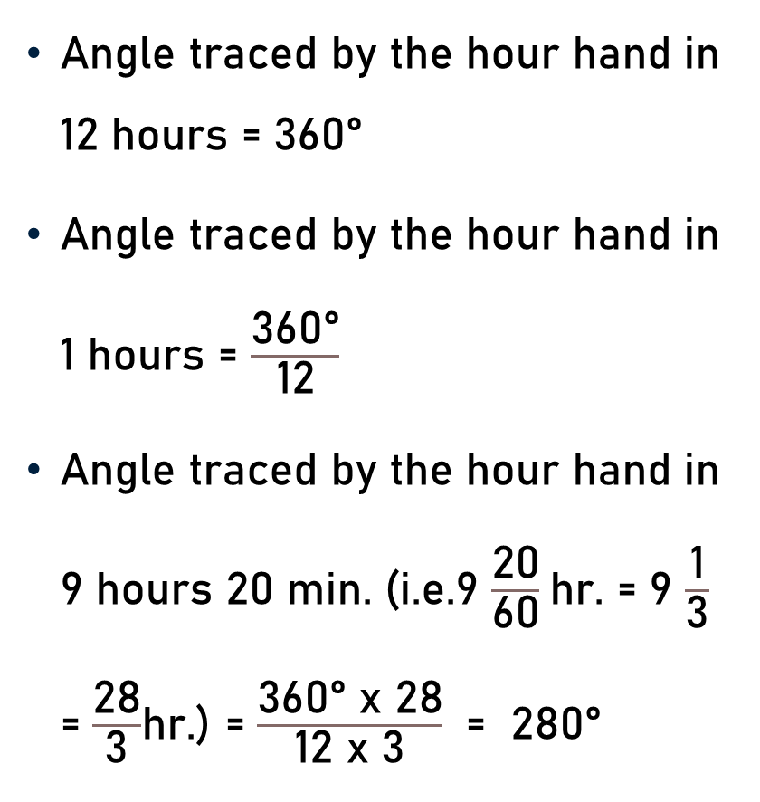

Example 1
Angle traced by the hour hand in 12 hours = 360°
Angle traced by the hour hand in 1 hours = $\frac{\text{360°}}{\text{12}}$
Angle traced by the hour hand in 9 hours 20 min. (i.e.9 $\frac{\text{20}}{\text{60}}$hr. = 9 $\frac{\text{1}}{\text{3}}$ = $\frac{\text{28}}{\text{3}}$hr.) = $\frac{\text{360° }\text{x}\text{ 28}}{\text{12 }\text{x}\text{ 3}}$ = 280°
280$\text{°}$

Slide 6

Example 1
Angle traced by minute hand in 20 min. = 120 °
Angle traced by the hour hand in 9 hours 20 min. = 280°
Angle between the minute hand and the hour hand of a clock when the time is 9.20 am = 280° - 120 ° = 160 °
160$\text{°}$

Slide 7
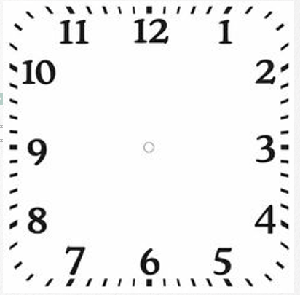
Example 2
At what time between 10 and 11 o’clock will the hands of a clock be together ?

Slide 8
Example 2
At 10 o’clock, the hour hand is at 10 and the minute hand is at 12, i.e. they are 10 min. spaces apart.
The minute hand is 10 minutes spaces ahead of the hour hand.
To be together, the minute hand must gain 50 minutes over the hour hand.

Slide 9
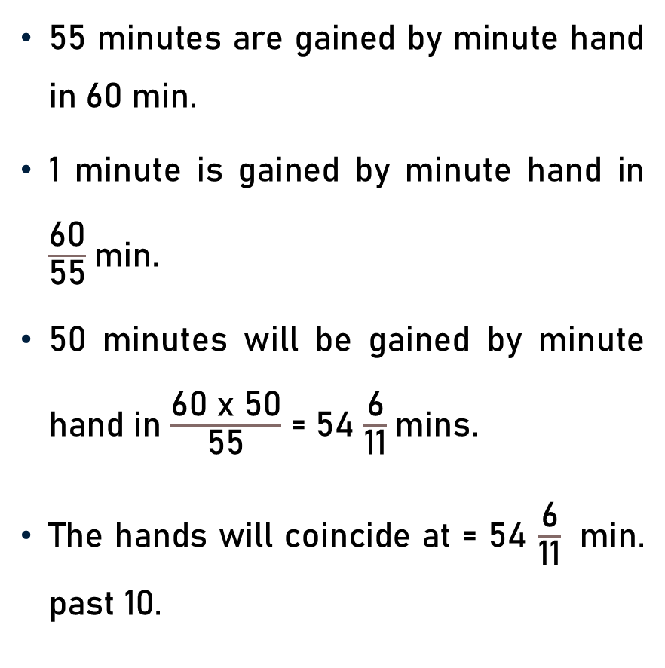
Example 2
55 minutes are gained by minute hand in 60 min.
1 minute is gained by minute hand in $\frac{\text{60}}{\text{55}}$min.
50 minutes will be gained by minute hand in $\frac{\text{60 }\text{x}\text{ 50}}{\text{55}}$ = 54 $\frac{\text{6}}{\text{1}\text{1}}$mins.
The hands will coincide at = 54 $\frac{\text{6}}{\text{1}\text{1}}$ min. past 10.

Slide 10
Example 3
At what time between 3 and 4 o’clock will the hands of a clock be together ?

Slide 11
Example 3
At 3 o’clock, the hour hand is at 3 and the minute hand is at 12, i.e. they are 15 min. spaces apart.
The minute hand is 15 minutes spaces behind of the hour hand.
To be together, the minute hand must gain 15 minutes over the hour hand.

Slide 12
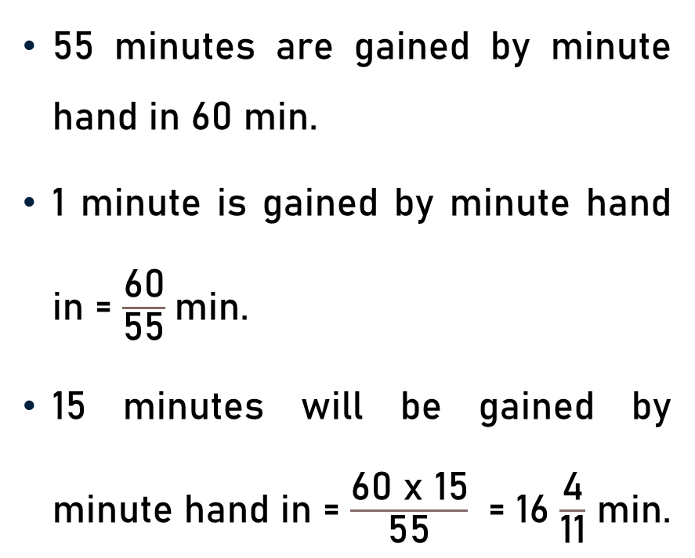

Example 3
55 minutes are gained by minute hand in 60 min.
1 minute is gained by minute hand in = $\frac{\text{60}}{\text{55}}$min.
15 minutes will be gained by minute hand in = $\frac{\text{60 }\text{x}\text{ 15}}{\text{55}}$ = 16 $\frac{\text{4}}{\text{1}\text{1}}$ min.
The hands will coincide at 16 $\frac{\text{4}}{\text{1}\text{1}}$ min past 3.

Slide 13
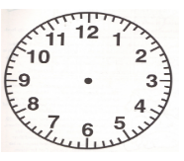
Example 4
At what time between 5 and 6 o’clock will the hands of a clock be at right angle?

Slide 14
Example 4
At 5 o’clock, the minute hand will be 25 min. spaces behind the hour hand.
When the two hands are 15 min. spaces apart, then they are at right angles.
Case I
  When minute hand is 15 min. spaces behind the hour hand.
Case II
  When the minute hand is 15 min. spaces ahead of the hour hand.

Slide 15
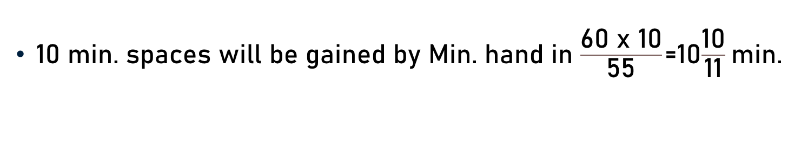
Case I
Min. hand is 15 min. behind the hour hand
Min. hand will have to gain
(25 – 15) = 10 minute spaces
55 min. spaces are gained Min. hand in 60 min.
10 min. spaces will be gained by Min. hand in $\frac{\text{60 }\text{x}\text{ 10}}{\text{55}}$ =10$\frac{\text{1}\text{0}}{\text{1}\text{1}}$min.

Slide 16
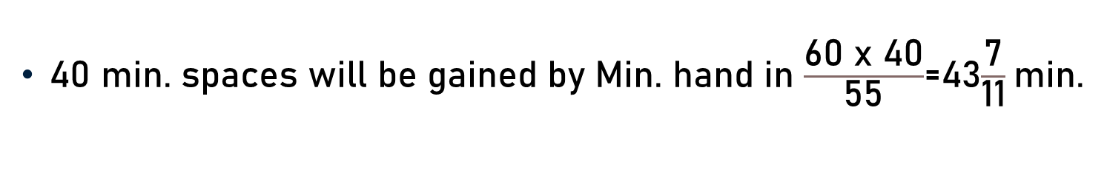
Case II
When the minute hand is 15 min. spaces ahead of the hour hand .
Min. hand will have to gain
(25 + 15) = 40 minute spaces
55 min. spaces are gained Min. hand in 60 min.
40 min. spaces will be gained by Min. hand in $\frac{\text{60 }\text{x}\text{ 40}}{\text{55}}$=43$\frac{\text{7}}{\text{11}}$min.

Slide 17
Example 5
Find at what time between 9 and 10 o’clock will the hands of a clock be in the same straight line but not together.
At 9 o’clock, the hour hand is at 9 and the minute hand is at 12, i.e. the two hands are 15 min. spaces apart.

Slide 18
Example 5
To be in the same straight line but not together they will be 30 minute spaces apart.
So, the minute hand will have to gain (30 – 15) = 15 min. spaces over the hour hand.

Slide 19
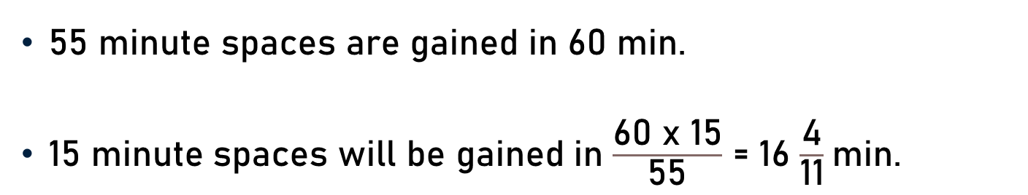
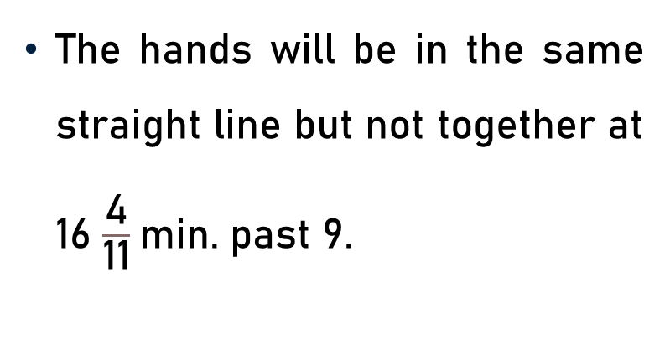
Example 5
55 minute spaces are gained in 60 min.
15 minute spaces will be gained in $\frac{\text{60 }\text{x}\text{ 15}}{\text{55}}$ = 16 $\frac{\text{4}}{\text{11}}$min.
The hands will be in the same straight line but not together at 16 $\frac{\text{4}}{\text{11}}$min. past 9.

Slide 20
Example 6
At what time between 8 and 9 o’clock are the hands of a clock 5 minutes apart?

Slide 21
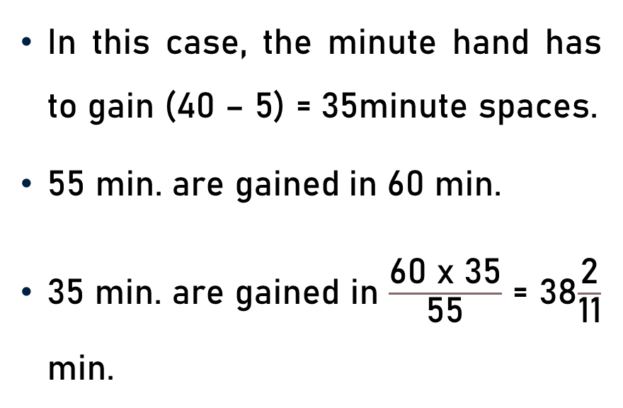

Case I -Minute hand is 3 min. spaces behind
At 8 o’clock, the minute hand is 40 min. spaces behind the hour hand.
In this case, the minute hand has to gain (40 – 5) = 35minute spaces.
55 min. are gained in 60 min.
35 min. are gained in $\frac{\text{60 }\text{x}\text{ 35}}{\text{55}}$ = 38$\frac{\text{2}}{\text{11}}$ min.
The hands will be 5 min. apart at 38 $\frac{\text{2}}{\text{11}}$ min. past 8.

Slide 22
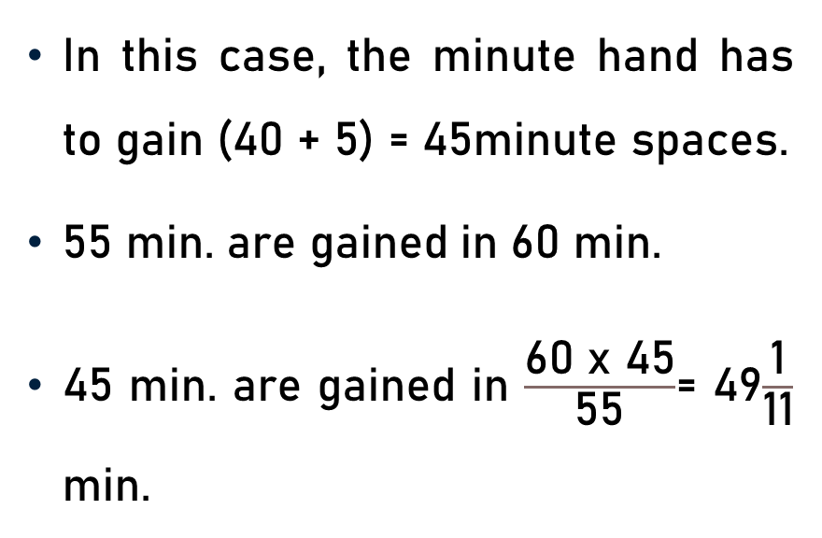

Case - II
At 8 o’clock, the minute hand is 40 min. spaces behind the hour hand.
In this case, the minute hand has to gain (40 + 5) = 45minute spaces.
55 min. are gained in 60 min.
45 min. are gained in $\frac{\text{60 }\text{x}\text{ 45}}{\text{55}}$= 49$\frac{\text{1}}{\text{11}}$ min.
The hands will be 5 min. apart at 49$\frac{\text{1}}{\text{11}}$min. past 8.

Slide 23
Example 7
Dhruvika leaves home between 8 a.m. and 9 a.m. and returns between 2 p.m. and 3 p.m. to find that the minute and hour hands have interchanged their positions. How long was Dhruvika out of the house?

Slide 24
Example 7
The hands will interchange positions after crossing each other 6 times i.e. they together will make (6 + 1) or 7 complete revolutions.

Slide 25
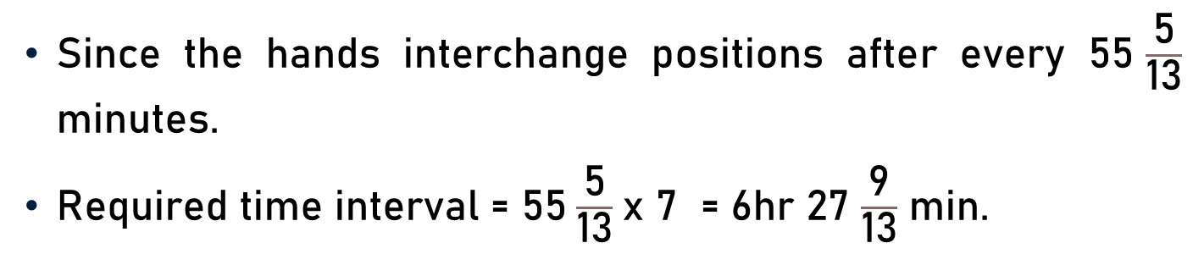
Example 7
Since the hands interchange positions after every 55$\frac{\text{5}}{\text{1}\text{3}}$ minutes.
Required time interval = 55$\frac{\text{5}}{\text{13}}$x 7 = 6hr 27 $\frac{\text{9}}{\text{1}\text{3}}$ min.

Slide 26
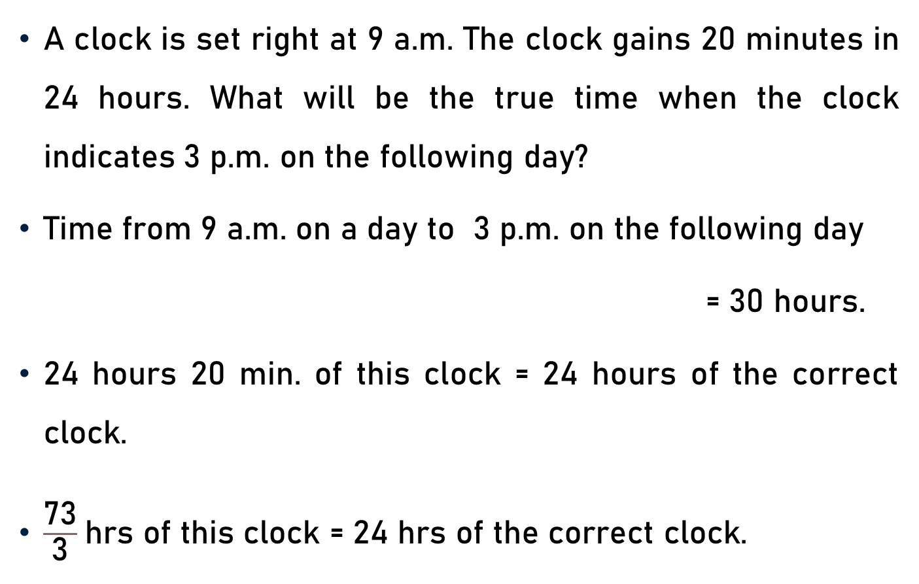
Example 8
A clock is set right at 9 a.m. The clock gains 20 minutes in 24 hours. What will be the true time when the clock indicates 3 p.m. on the following day?
Time from 9 a.m. on a day to 3 p.m. on the following day
= 30 hours.
24 hours 20 min. of this clock = 24 hours of the correct clock.
$\frac{\text{73}}{\text{3}}$hrs of this clock = 24 hrs of the correct clock.

Slide 27
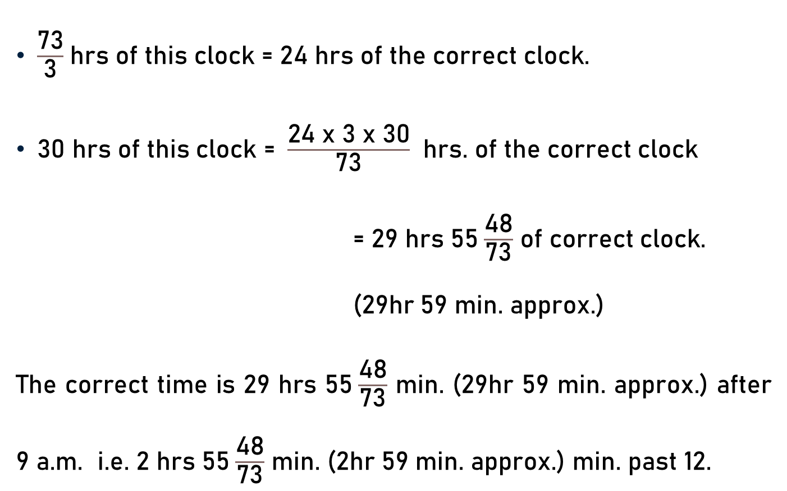
Example 8
$\frac{\text{73}}{\text{3}}$hrs of this clock = 24 hrs of the correct clock.
30 hrs of this clock = $\frac{\text{24 }\text{x}\text{ 3 }\text{x}\text{ 30}}{\text{73}}$ hrs. of the correct clock
= 29 hrs 55$\frac{\text{48}}{\text{73}}$ of correct clock.
(29hr 59 min. approx.)
The correct time is 29 hrs 55$\frac{\text{48}}{\text{73}}$ min. (29hr 59 min. approx.) after 9 a.m. i.e. 2 hrs 55$\frac{\text{48}}{\text{73}}$ min. (2hr 59 min. approx.) min. past 12.

Slide 28
Example 9
A clock is set right at 5 a.m. The clock loses 16 minutes in 24 hours. What will be the true time when the clock indicates 10 p.m. on 4th day?
Time from 5 a.m. on a day to 10 p.m. on 4th day = 89 hours.
Now 23 hrs 44 min. of this clock = 24 hours of correct clock.

Slide 29
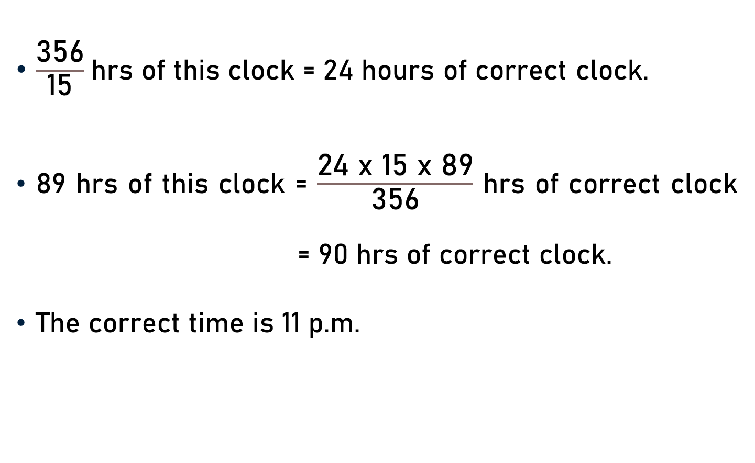
Example 9
$\frac{\text{356}}{\text{15}}$hrs of this clock = 24 hours of correct clock.
89 hrs of this clock = $\frac{\text{24 }\text{x}\text{ 15 }\text{x}\text{ 89}}{\text{356}}$ hrs of correct clock = 90 hrs of correct clock.
The correct time is 11 p.m.

Slide 30
Example 10
The minute hand of a clock overtakes the hour hand at intervals of 65 minutes of the correct time. How much a day does the clock gain or lose?
In a correct clock, the minute hand gains 55 min. spaces over the hour hand in 60 minutes.
To be together again, the minute hand must gain 60 minutes over the hour hand.

Slide 31
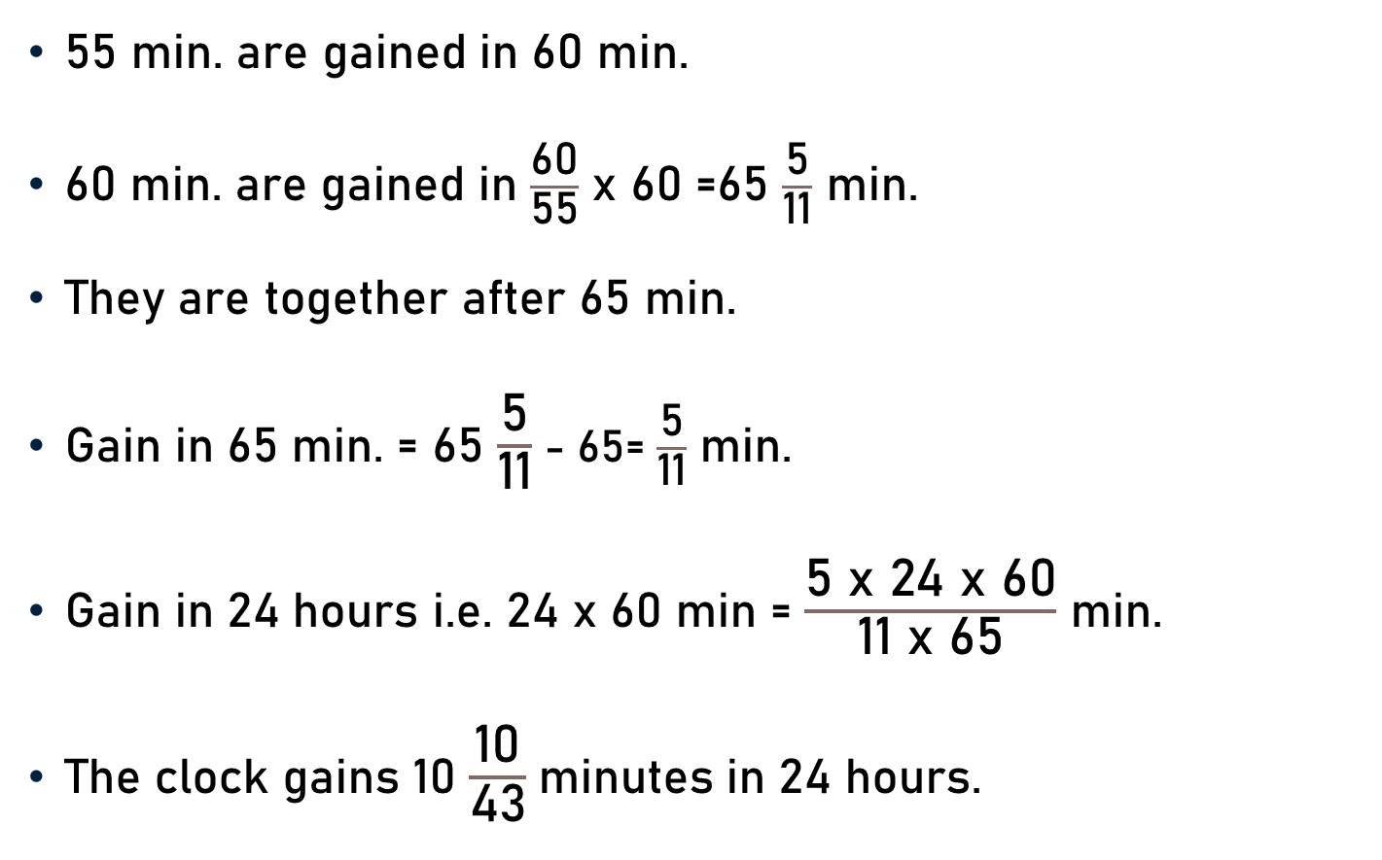
Example 10
55 min. are gained in 60 min.
60 min. are gained in $\frac{\text{60}}{\text{55}}$ x 60 =65 $\frac{\text{5}}{\text{11}}$ min.
They are together after 65 min.
Gain in 65 min. = 65 $\frac{\text{5}}{\text{11}}$ - 65= $\frac{\text{5}}{\text{11}}$ min.
Gain in 24 hours i.e. 24 x 60 min = $\frac{\text{5 }\text{x}\text{ 24 }\text{x}\text{ 60}}{\text{11 }\text{x}\text{ 65}}$ min.
The clock gains 10 $\frac{\text{10}}{\text{43}}$minutes in 24 hours.

Slide 32
Conclusion
Angle between the hour hand and the minute hand of a clock.
The hands of a clock be together (coincide).
The hands of a clock be at right angle.
The hands of a clock be in the same straight line (not together).
Time - Hands of a clock x minutes apart.
True time - Clock gains or loses in x minutes in 24 hours.

Slide 33
Summary
Computation of angle between hands of clock in different situations.

